Slide 1
SORTONS EVENTS
Let’S GO OUT!

Slide 2
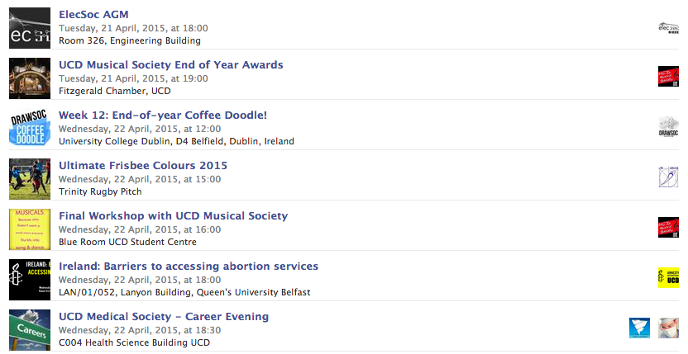
UCD EVENTS

Slide 3
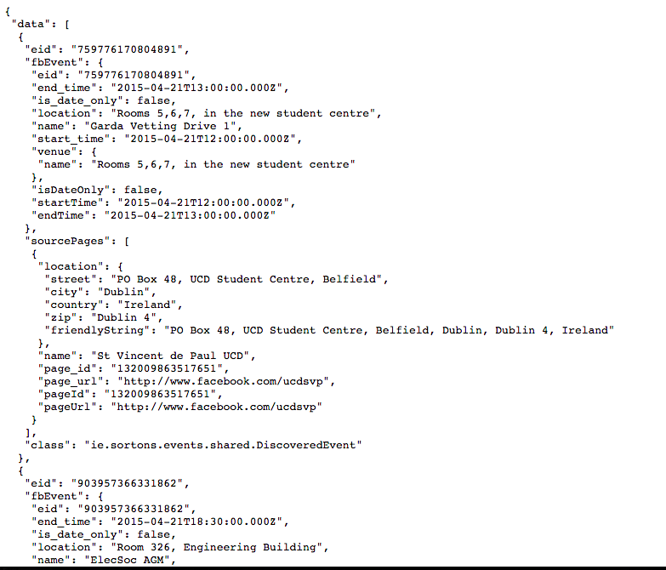
GooGLE APP ENGINE

Slide 4
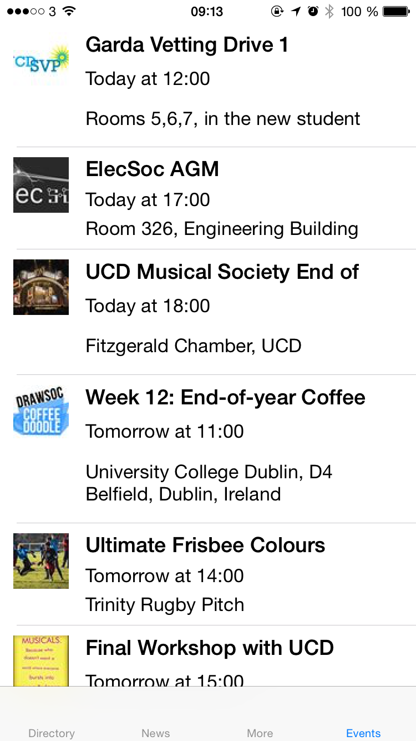
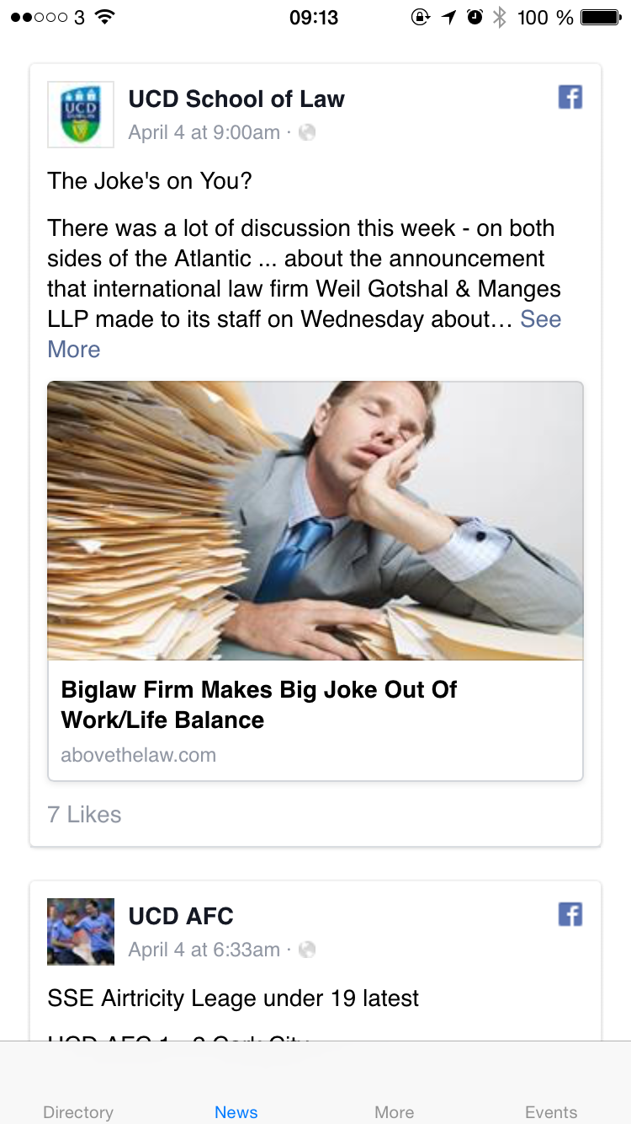
FOUR VIEWS

Slide 5

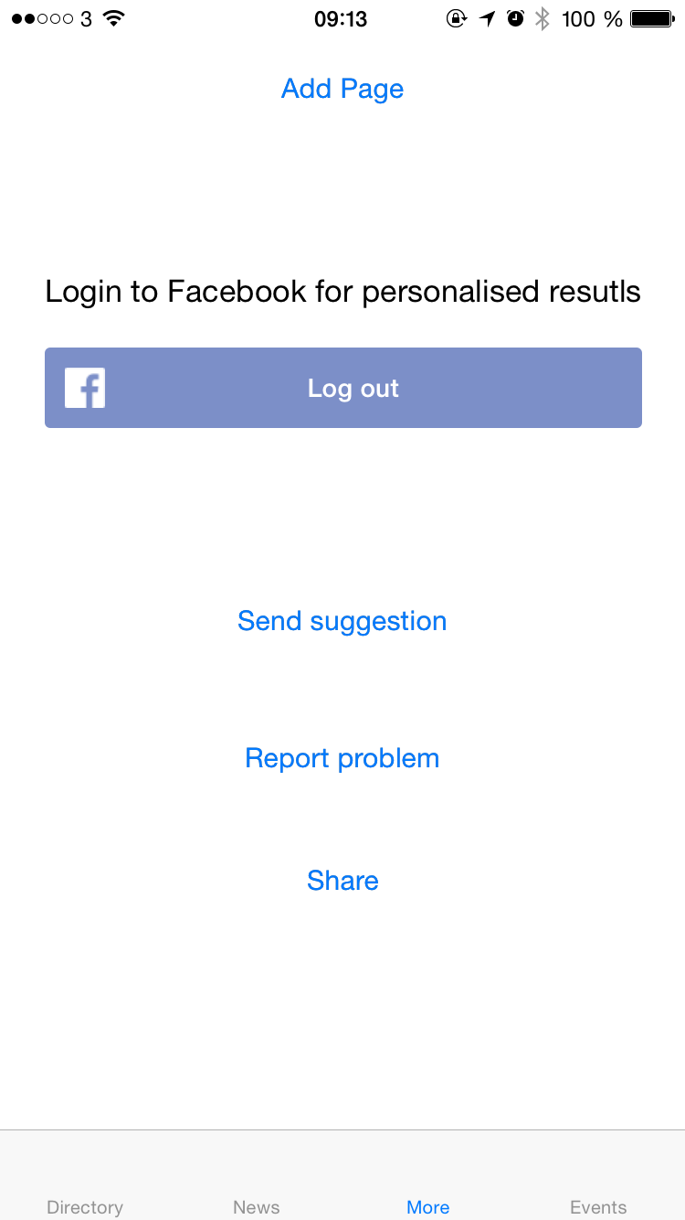
FOUR VIEWS

Slide 6
TABLEVIEWCONTROLLER
Not UITableViewController
Transparent Status Bar
TabViewController hiding content
ASyncImageView
NSDateFormatter
fb://profile/ scheme
UITableViewAutomaticDimension
performSelectorOnMainThread

Slide 7
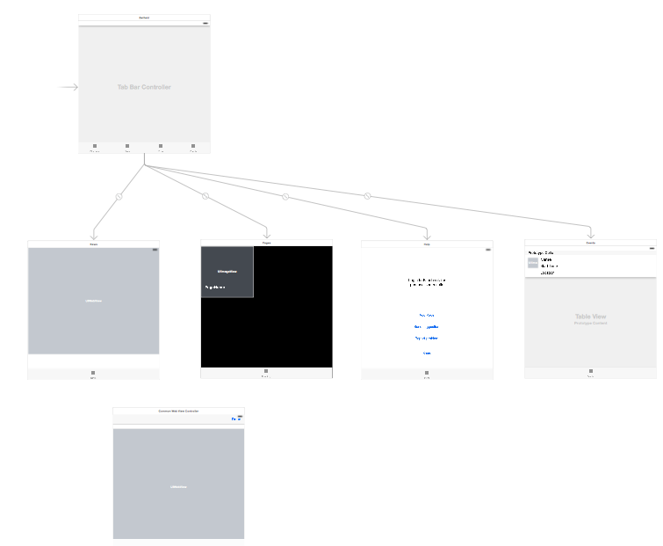
UIWebViewDelegate
Cross-Origin Resource Sharing
Facebook Bug
shouldStartLoadWithRequest -> Second WebView
Not connected on Storyboard

Slide 8
UICollectionViewController
Almost the same as TableViewController
Nicer on iPad
Missing: search and sorting

Slide 9
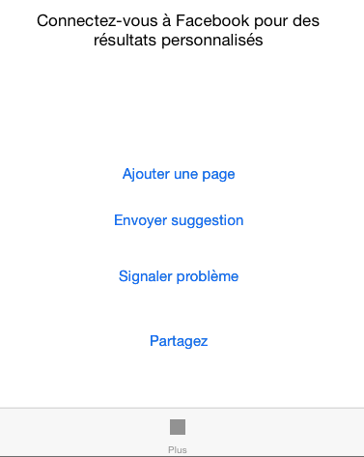
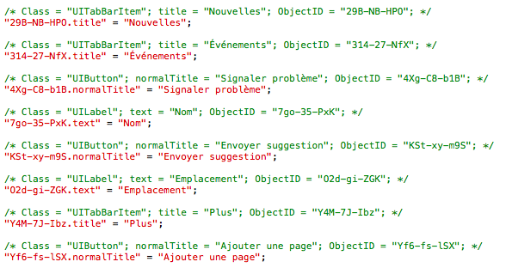
UIViewController
Facebook SDK
Feedback
Localization

Slide 10
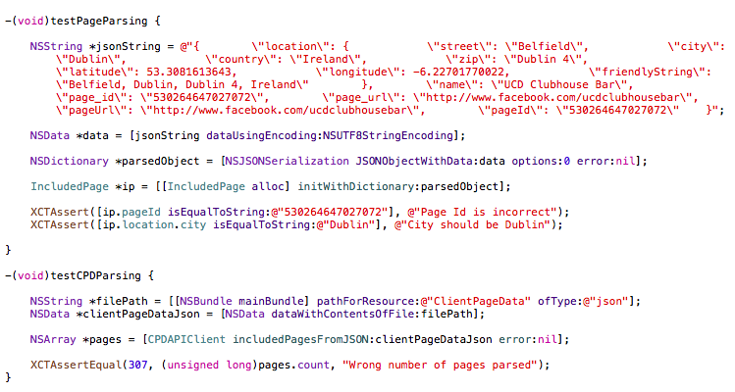
TDD

Slide 11
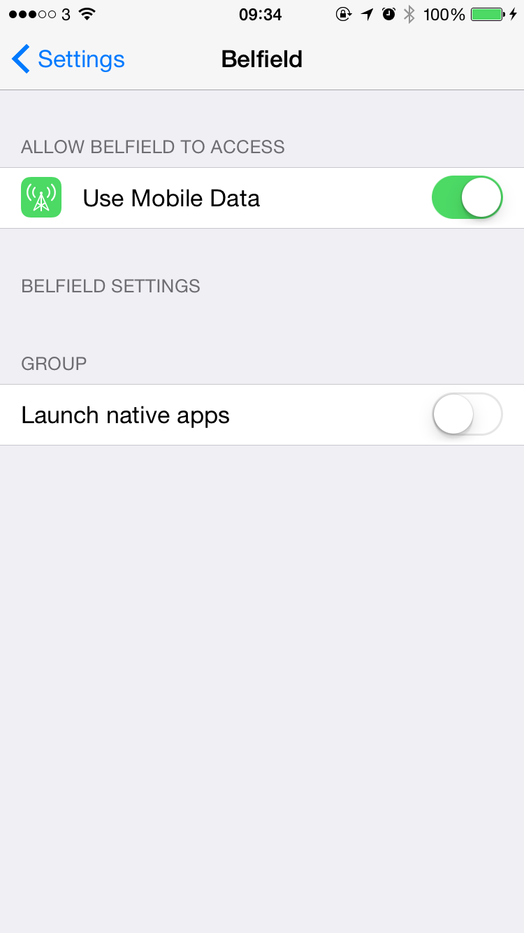
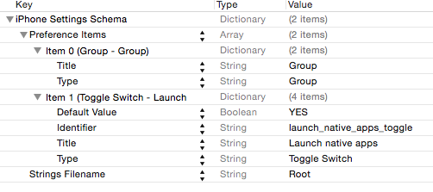

Settings.app

Slide 12
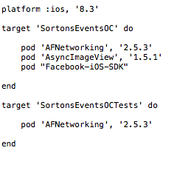
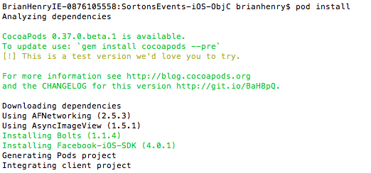
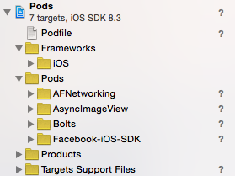
Cocoa Pods

Slide 13
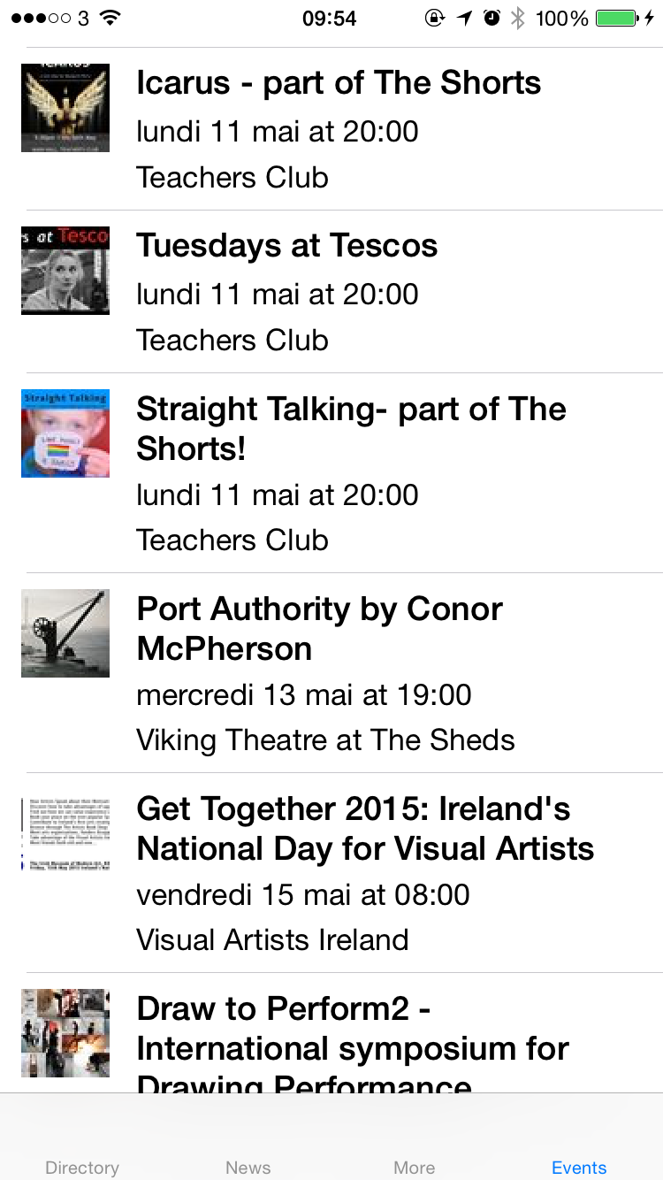
Dublin Theatre

Slide 14
NEXT STEPS
App Store
Core Data
Crash reports
Analytics
Siri
Watch
Notification Screen
How to monetize?

Slide 15
websites
http://nshipster.com
http://www.raywenderlich.com
https://developer.apple.com
http://www.appcoda.com
http://learnxinyminutes.com/docs/objective-c/
http://www.makeappicon.com

